Slide 1
Loaders and Linkers
Chapter 3
System Software
An introduction to systems programming
Leland L. Beck

Slide 2
Introduction
To execute an object program, we needs
  Relocation, which modifies the object program so that it can be loaded at an address different from the location originally specified
  Linking, which combines two or more separate object programs and supplies the information needed to allow references between them
  Loading and Allocation, which allocates memory location and brings the object program into memory for execution

Slide 3
Overview of Chapter 3
Type of loaders
  assemble-and-go loader
  absolute loader (bootstrap loader)
  relocating loader (relative loader)
  direct linking loader
Design options
  linkage editors
  dynamic linking
  bootstrap loaders

Slide 4
Assemble-and-go Loader
Characteristic
  the object code is stored in memory after assembly
  single JUMP instruction
Advantage
  simple, developing environment
Disadvantage
  whenever the assembly program is to be executed, it has to be assembled again
  programs have to be coded in the same language

Slide 5
Design of an Absolute Loader
Absolute Program
  Advantage
    Simple and efficient
  Disadvantage
    the need for programmer to specify the actual address
    difficult to use subroutine libraries
Program Logic

Slide 6
Fig. 3.2 Algorithm for an absolute loader
Begin
read Header record
verify program name and length
read first Text record
while record type is not ‘E’ do
begin
{if object code is in character form, convert into internal representation}
move object code to specified location in memory
read next object program record
end
jump to address specified in End record
end

Slide 7
Object Code Representation
Figure 3.1 (a)
  each byte of assembled code is given using its hexadecimal representation in character form
  easy to read by human beings
In general
  each byte of object code is stored as a single byte
  most machine store object programs in a binary form
  we must be sure that our file and device conventions do not cause some of the program bytes to be interpreted as control characters

Slide 8
A Simple Bootstrap Loader
Bootstrap Loader
  When a computer is first tuned on or restarted, a special type of absolute loader, called bootstrap loader is executed
  This bootstrap loads the first program to be run by the computer -- usually an operating system
Example (SIC bootstrap loader)
  The bootstrap itself begins at address 0
  It loads the OS starting address 0x80
  No header record or control information, the object code is consecutive bytes of memory

Slide 9
Fig. 3.3 SIC Bootstrap Loader Logic
Begin
X=0x80 (the address of the next memory location to be loaded
Loop
A←GETC (and convert it from the ASCII character code to the value of the hexadecimal digit)
save the value in the high-order 4 bits of S
A←GETC
combine the value to form one byte A← (A+S)
store the value (in A) to the address in register X
X←X+1
End
0~9 : 48
A~F : 65
GETC A←read one character
if A=0x04 then jump to 0x80
if A<48 then GETC
A ← A-48 (0x30)
if A<10 then return
A ← A-7 (48+7=55)
return

Slide 10
Relocating Loaders
Motivation
  efficient sharing of the machine with larger memory and when several independent programs are to be run together
  support the use of subroutine libraries efficiently
Two methods for specifying relocation
  modification record (Fig. 3.4, 3.5)
  relocation bit (Fig. 3.6, 3.7)
    each instruction is associated with one relocation bit
    these relocation bits in a Text record is gathered into bit masks

Slide 11
Modification Record
For complex machines
Also called RLD specification
  Relocation and Linkage Directory
Modification record
  col 1: M
  col 2-7: relocation address
  col 8-9: length (halfbyte)
  col 10: flag (+/-)
  col 11-17: segment name

Slide 12
Relocation Bit
For simple machines
Relocation bit
  0: no modification is necessary
  1: modification is needed
Twelve-bit mask is used in each Text record
  since each text record contains less than 12 words
  unused words are set to 0
  any value that is to be modified during relocation must coincide with one of these 3-byte segments
    e.g. line 210
Text record
  col 1: T
  col 2-7: starting address
  col 8-9: length (byte)
  col 10-12: relocation bits
  col 13-72: object code

Slide 13
Program Linking
Goal
  Resolve the problems with EXTREF and EXTDEF from different control sections
Linking
  1. User, 2. Assembler, 3. Linking loader
Example
  Program in Fig. 3.8 and object code in Fig. 3.9
  Use modification records for both relocation and linking
    address constant
    external reference

Slide 14
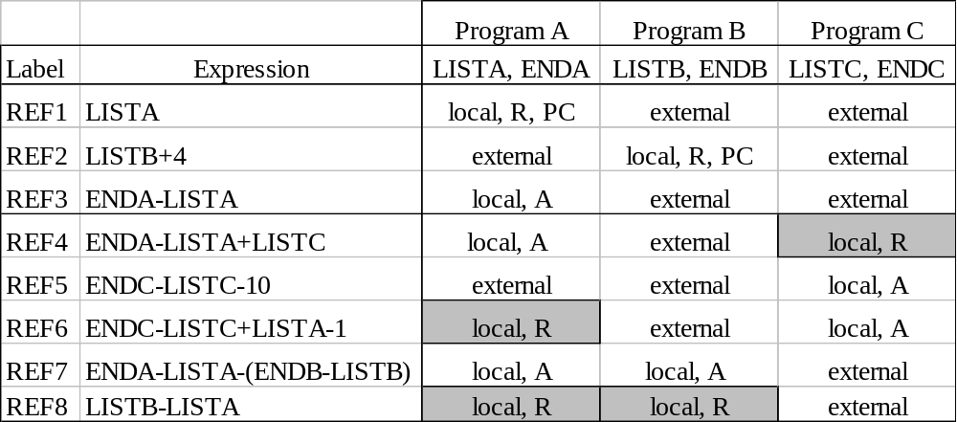
Program Linking Example

Slide 15
Program Linking Example
Fig. 3.10
Load address for control sections
  PROGA 004000 63
  PROGB 004063 7F
  PROGC 0040E2 51
Load address for symbols
  LISTA: PROGA+0040=4040
  LISTB: PROGB+0060=40C3
  LISTC: PROGC+0030=4112
REF4 in PROGA
  ENDA-LISTA+LISTC=14+4112=4126
  T0000540F000014FFFFF600003F000014FFFFC0
  M00005406+LISTC

Slide 16
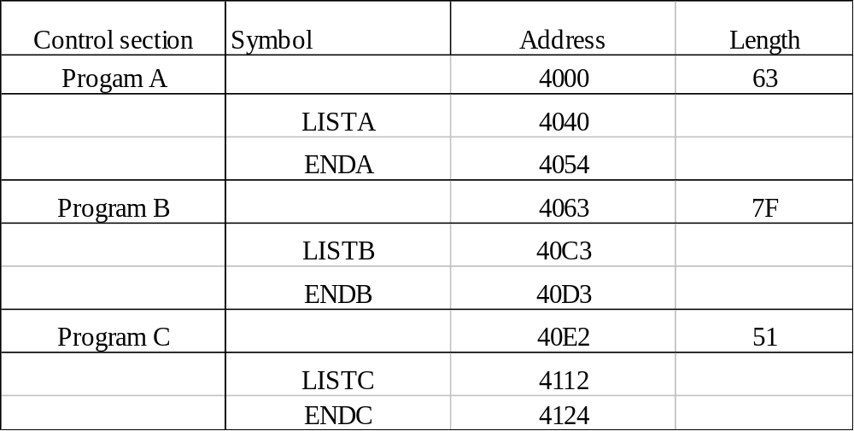
Program Logic and Data Structure
Two Passes Logic
  Pass 1: assign addresses to all external symbols
  Pass 2: perform the actual loading, relocation, and linking
ESTAB (external symbol table)

Slide 17
Pass 1 Program Logic
Pass 1:
  assign addresses to all external symbols
Variables
  PROGADDR (program load address) from OS
  CSADDR (control section address)
  CSLTH (control section length)
  ESTAB
Fig. 3.11(a)
  Process Define Record

Slide 18
Pass 2 Program Logic
Pass 1:
  perform the actual loading, relocation, and linking
Modification record
  lookup the symbol in ESTAB
End record for a main program
  transfer address
Fig. 3.11(b)
  Process Text record and Modification record

Slide 19
Improve Efficiency
Use local searching instead of multiple searches of ESTAB for the same symbol
  assign a reference number to each external symbol
  the reference number is used in Modification records
Implementation
  01: control section name
  other: external reference symbols
Example
  Fig. 3.12

Slide 20
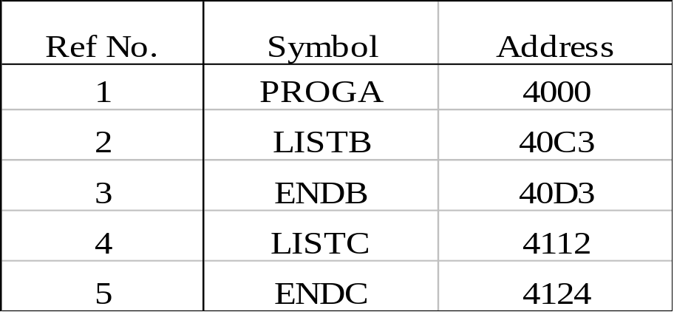
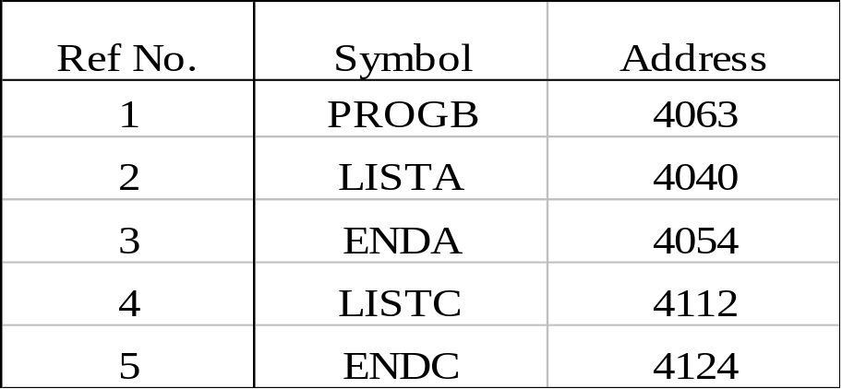
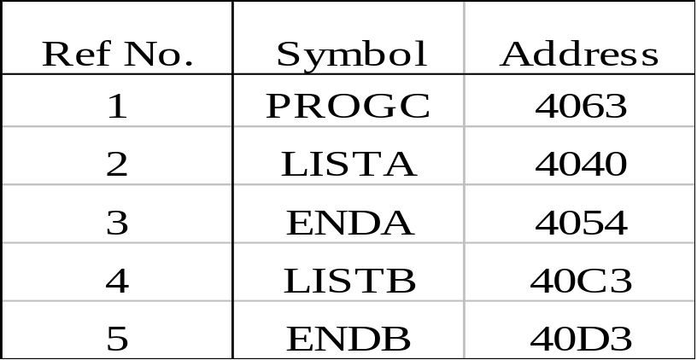
Figure 3.12
PROGA
PROGB PROGC

